Slide 1
Discrete Mathematics and Its Application 7th edition, 2001
Kenneth H. Rosen

Slide 2
Welcome to Discrete Mathematics Spring 2018
Instructor: Niu Shao Zhang

Slide 3
§5.4 Recursive Algorithms
Section Summary
Recursive Algorithms
Proving Recursive Algorithms Correct
Recursion and Iteration (not yet included in overheads)
Merge Sort

Slide 4
Recursive Algorithms
Definition: An algorithm is called recursive if it solves a problem by reducing it to an instance of the same problem with smaller input.
(一个算法通过把问题归为带更小输入的相同问题来解决)
For the algorithm to terminate, the instance of the problem must eventually be reduced to some initial case for which the solution is known.（需要初始条件）

Slide 5
Recursive Factorial Algorithm
Example: Give a recursive algorithm for computing n!, where n is a nonnegative integer.
Solution: Use the recursive definition of the factorial function.
procedure factorial(n: nonnegative integer)
if n = 0 then return 1
else return n∙(n − 1)
{output is n!}

Slide 6
Recursive Exponentiation Algorithm
Example: Give a recursive algorithm for computing a^{n}, where a is a nonzero real number and n is a nonnegative integer.
Solution: Use the recursive definition of a^{n}.
procedure power(a: nonzero real number, n: nonnegative integer)
if n = 0 then return 1
else return a∙ power (a, n − 1)
{output is a^{n}}

Slide 7
Recursive GCD Algorithm
Example: Give a recursive algorithm for computing the greatest common divisor of two nonnegative integers a and b with a < b.
Solution: Use the reduction
gcd(a,b) = gcd(b mod a, a)
and the condition gcd(0,b) = b when b > 0.
procedure gcd(a,b: nonnegative integers
with a < b)
if a = 0 then return b
else return gcd (b mod a, a)
{output is gcd(a, b)}

Slide 8
Recursive Modular Exponentiation Algorithm
Example: Devise a a recursive algorithm for computing b^{n} mod m, where b, n, and m are integers with m ≥ 2, n ≥ 0, and 1≤ b ≤ m.
Solution:
(see text for full explanation)
procedure mpower(b,m,n: integers with b > 0 and m ≥ 2, n ≥ 0)
if n = 0 then
return 1
else if n is even then
return mpower(b,n/2,m)² mod m
else
return (mpower(b,⌊n/2⌋,m)² mod m∙ b mod m) mod m
{output is b^{n} mod m}

Slide 9
Recursive Binary Search Algorithm
Example: Construct a recursive version of a binary search algorithm.
Solution: Assume we have a₁,a₂,…, a_{n}, an increasing sequence of integers. Initially i is 1 and j is n. We are searching for x.
procedure binary search(i, j, x : integers, 1≤ i ≤ j ≤n)
m := ⌊(i + j)/2⌋
if x = a_{m} then
return m
else if (x < a_{m} and i < m) then
return binary search(i,m−1,x)
else if (x > a_{m} and j >m) then
return binary search(m+1,j,x)
else return 0
{output is location of x in a₁, a₂,…,a_{n} if it appears, otherwise 0}

Slide 10
Proving Recursive Algorithms Correct
Both mathematical and str0ng induction are useful techniques to show that recursive algorithms always produce the correct output.
Example: Prove that the algorithm for computing the powers of real numbers is correct.
Solution: Use mathematical induction on the exponent n.
BASIS STEP: a⁰ =1 for every nonzero real number a, and power(a,0) = 1.
INDUCTIVE STEP: The inductive hypothesis is that power(a,k) = a^{k}, for all a ≠0. Assuming the inductive hypothesis, the algorithm correctly computes a^{k+1}, since
power(a,k + 1) = a∙ power (a, k) = a∙ a^{k} = a^{k+1} .
procedure power(a: nonzero real number, n: nonnegative integer)
if n = 0 then return 1
else return a∙ power (a, n − 1)
{output is a^{n}}

Slide 11
Merge Sort
Merge Sort works by iteratively splitting a list (with an even number of elements) into two sublists of equal length until each sublist has one element.
Each sublist is represented by a balanced binary tree.

Slide 12
Merge Sort
At each step a pair of sublists is successively merged into a list with the elements in increasing order. The process ends when all the sublists have been merged.
The succession of merged lists is represented by a binary tree.

Slide 13
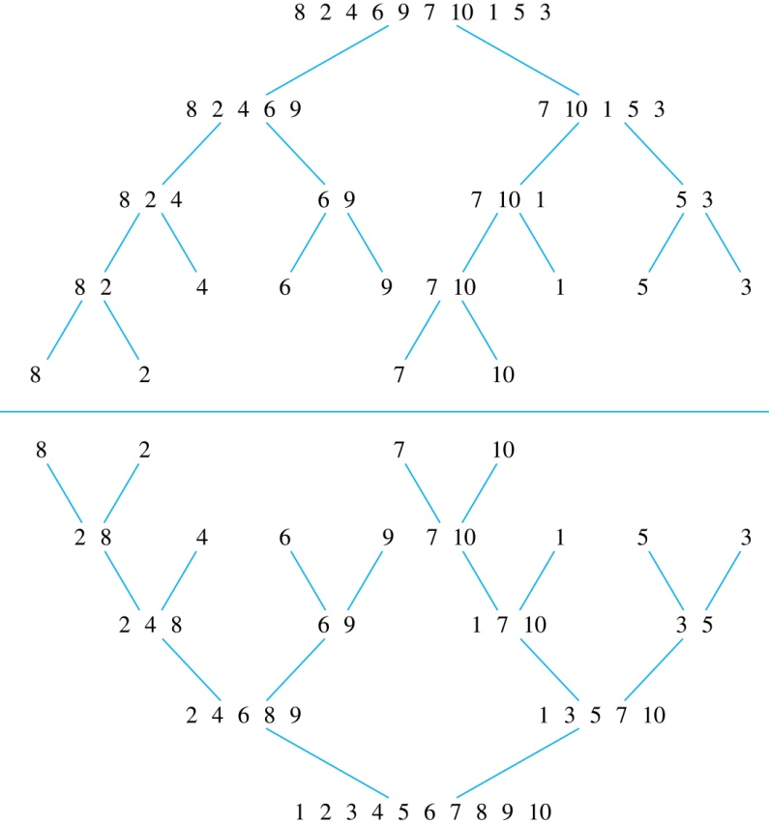
Merge Sort
Example: Use merge sort to put the list
8,2,4,6,9,7,10, 1, 5, 3
into increasing order.
Solution:

Slide 14
Recursive Merge Sort
Example: Construct a recursive merge sort algorithm.
Solution: Begin with the list of n elements L.
procedure mergesort(L = a₁, a₂,…,a_{n} )
if n > 1 then
m := ⌊n/2⌋
L₁ := a₁, a₂,…,a_{m}
L₂ := a_{m+1}, a_{m+2},…,a_{n}
L := merge(mergesort(L₁), mergesort(L₂ ))
{L is now sorted into elements in increasing order}
continued →

Slide 15
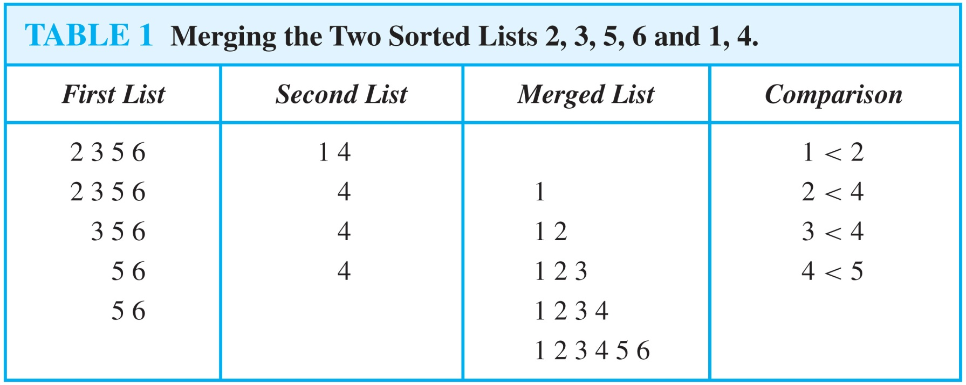
Merging Two Lists
Example: Merge the two lists 2,3,5,6 and 1,4.
Solution:

Slide 16
Recursive Merge Sort
Subroutine merge, which merges two sorted lists.
Complexity of Merge: Two sorted lists with m elements and n elements can be merged into a sorted list using no more than m + n − 1 comparisons.
procedure merge(L₁, L₂ :sorted lists)
L := empty list
while L₁ and L₂ are both nonempty
remove smaller of first elements of L₁ and L₂ from its list;
put at the right end of L
if this removal makes one list empty
then remove all elements from the other list and append them to L
return L {L is the merged list with the elements in increasing order}

Slide 17
Complexity of Merge Sort
Complexity of Merge Sort: The number of comparisons needed to merge a list with n elements is O(n log n).
For simplicity, assume that n is a power of 2, say 2^{m}.
At the end of the splitting process, we have a binary tree with m levels, and 2^{m} lists with one element at level m.
The merging process begins at level m with the pairs of 2^{m} lists with one element combined into 2^{m−1} lists of two elements. Each merger takes two one comparison.
The procedure continues , at each level (k = m, m−1, m−1,…,3,2,1) 2^{k} lists with 2^{m−k} elements are merged into 2^{k−1} lists, with 2^{m−k + 1} elements at level k−1.
We know (by the complexity of the merge subroutine) that each merger takes at most 2^{m−k} + 2^{m−k} − 1 = 2^{m−k+ 1} − 1 comparisons.
continued →

Slide 18
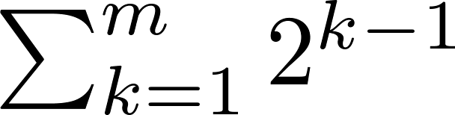
Complexity of Merge Sort
Summing over the number of comparisons at each level, shows that
because m = log n and n = 2^{m}.
(The expression in the formula above is evaluated as 2^{m} − 1 using the formula for the sum of the terms of a geometric progression, from Section 2.4.)
In Chapter 11, we’ll see that the fastest comparison-based sorting algorithms have O(n log n) time complexity. So, merge sort achieves the best possible big-O estimate of time complexity.

Slide 19
§5.5 Program Veriﬁcation
A program, or program segment, S is said to be partially correct with respect to the initial assertion p and the ﬁnal assertion q if whenever p is true for the input values of S and S terminates, then q is true for the output values of S.
The notation p{S}q is known as a Hoare triple.

Slide 20
Rules of Inference
composition rule:A useful rule of inference proves that a program is correct by splitting the program into a sequence of subprograms and then showing that each subprogram is correct.
p{S1}q
q{S2}r
∴ p{S1;S2}r.

Slide 21
Conditional Statements
(p∧condition){S}q
(p∧¬condition) → q
∴ p{if condition then S}q.
(p∧condition){S1}q
(p∧¬condition){S2}q
∴ p{if condition then S1 else S2}q.

Slide 22
Loop Invariants
while condition S
p is a loop invariant if (p∧condition){S}p is true.
(p∧condition){S}p
∴ p{while condition S}(¬condition ∧p).

